Slide 1

West Contra Costa
Unified School District
April 13, 2011
2011-12
Budget Update
Board Meeting

Slide 2
State Update
Certain legislation has passed that corresponds to the Governor’s January Plan
Tax extension legislation for June was not successful
The plans for May revision are unknown

Slide 3

Threats to Current Budget
State Economic Crisis Continues
Three Hurdles Remain
    Legislature must adopt cuts to programs such as health and social services
    Legislature must agree to place an extension of taxes on the June ballot
    California taxpayers must agree to these taxes to preserve education

Slide 4
What do we do now?

Slide 5

Local Outlook
Positive Certification of Second Interim
Budget Reductions and one-time solutions recommended for 2011-12 will result in a 3% reserve – Assumes the $349 cut
Deficit spending projection in 2012-13 spends fund balance

Slide 6
Local Outlook
Budget adoption occurs in June 2011
  Must include Multi Year projection for 2012-13 and 2013-14
  One time solutions are depleted in 2012-13
  Absent economic recovery and Legislative solutions major cuts will be necessary

Slide 8
Multi Year Projection - Second Interim Report
Unrestricted General Fund
January 31, 2011
 | 2010-11 | 2011-12 | 2012-13
Revenues | $139,891 | $135,203 | $126,838
Expenses | 137,311 | 135,203 | 135,205
Change in Fund Balance | 2,580 | 0 | (8,367)
Beginning Fund Balance | 15,439 | 18,019 | 18,019
Ending Fund Balance | 18,019 | 18,019 | 9,652
Required Reserve | 8,679 | 7,798 | 7,692
Stores & Revolving Cash | 300 | 300 | 300
Dollars shown in thousands

Slide 9
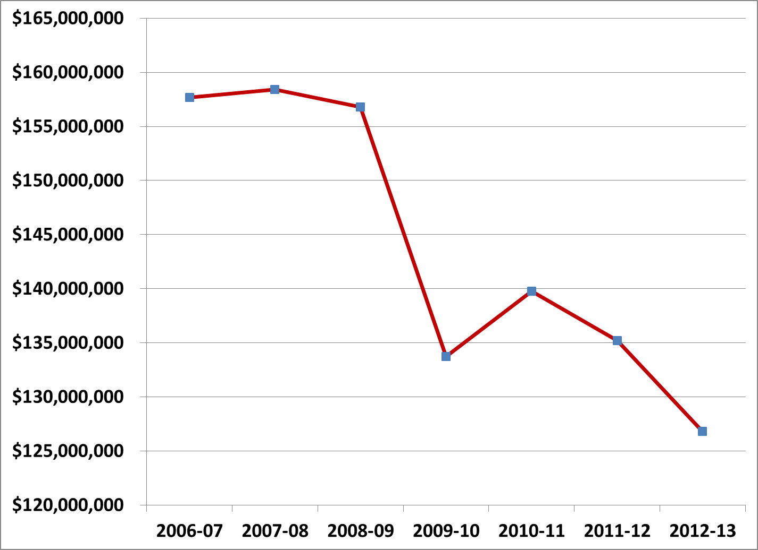
WCCUSD General Fund 2006-2012

Slide 10
Multi Year Projection - Second Interim Report Basis
Unrestricted General Fund
April 2011
$800 per pupil cut estimate
 | 2010-11 | 2011-12 | 2012-13
Revenues | $139,891 | $125,203 | $116,638
Expenses | 137,311 | 135,203 | 135,205
Change in Fund Balance | 2,580 | (10,200) | (18,567)
Beginning Fund Balance | 15,439 | 18,019 | 7,819
Ending Fund Balance | 18,019 | 7,819 | (10,748)
Required Reserve | 8,679 | 7,798 | 7,692
Stores & Revolving Cash | 300 | 300 | 300

Slide 11
Timeline
February 23
  Board Meeting on Budget
March 2
  Layoff Notice – Teachers and Administrators
March 16
  Second Interim Report
April
  Classified Layoff Notice – Categorical and Grant
    Board action for non-grant
    Letters for grant funded per Ed Code 45117
May
  Governor’s May Revision
  Consider additional reductions
June
  State Election ?
  Budget Adoption

